Slide 1
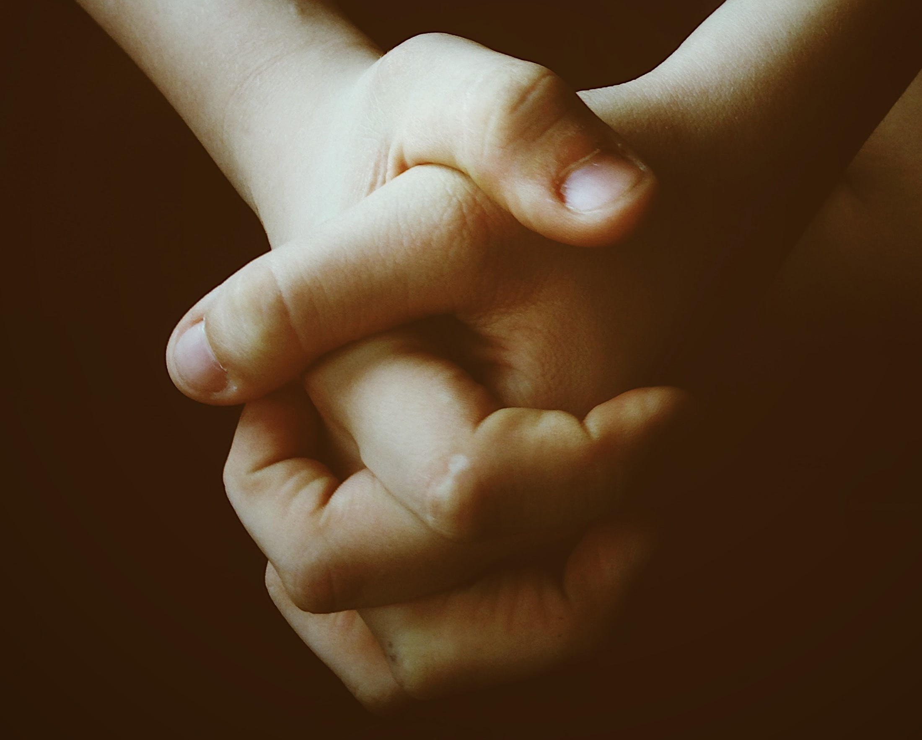
Did You Think to Pray?
(James 5:13-18)
Photo by Jon Tyson on Unsplash

Slide 2
Introduction:
When the going gets tough, we need patience (James 5:7).
We are not to vent our feelings on others (James 5:9).
Prayer is mentioned seven times in James 5:13-18.
Whatever our situation in life, prayer is always appropriate.
There is power in prayer.

Slide 3
Pray when troubled (5:13)
Make a list of problems (physical, emotional, financial, family, career, etc.).
What are we do to? Pray!
We can pray to a Lord who understands.
¹⁵ For we do not have a High Priest who cannot sympathize with our weaknesses, but was in all points tempted as we are, yet without sin. ¹⁶ Let us therefore come boldly to the throne of grace, that we may obtain mercy and find grace to help in time of need. (cf. Hebrews 4:15, 16).

Slide 4
Pray when times are bad.
There are two extremes when it comes to prayer.
Worry instead of praying
Fail to pray when everything is right
“Speak to yourselves in psalms…” (Eph. 5:19,20).
Direct these to God
Prayer songs
“We Praise Thee, O God”
Encourage one another, “yourselves”

Slide 5
Pray when there is illness.
Notice James 5:14-16.
Affliction in specific illnesses (physical); helping someone get better and getting them out of bed
This passage was written in a time when miraculous gifts were a part of God’s plan (cf. 1 Cor. 13:8-10).
Elders are spiritual people who care for church members.
Think of the character of the Good Samaritan (cf. Luke 10:34).

Slide 6
James is not talking about the doctrine of “extreme uncion” or “last rites.”
The oil was to make the patient well not prepare him or her for death.
The faith involved was of the prayer for the sick.
This rules out moden faith healers (“fake healers”).
Pray according to God’s will.
Note: “will avail much.” How much is much?

Slide 7
Pray when there is sin.
Notice James 5:15.
Sin is evidence of spiritual sickness.
We have to choose between a certain lifestyle of life itself.
Pray for each other (James 5:16).
Praying for one another is not limited to prayer following a public confession of sin.
There is power in prayer!

Slide 8
Pray because prayer is powerful.
Notice James 5:16-18.
God responds to His children.
²⁸ And we know that all things work together for good to those who love God, to those who are the called according to His purpose” (Rom. 8:28).
¹¹ If you then, being evil, know how to give good gifts to your children, how much more will your Father who is in heaven give good things to those who ask Him! (Matt. 7:11).

Slide 9
Recall Elijah praying to the Lord asking for fire from heaven to consume the altar with an offering (1 Kings 18:36, 37).
³⁶ And it came to pass, at the time of the offering of the evening sacrifice, that Elijah the prophet came near and said, “Lord God of Abraham, Isaac, and Israel, let it be known this day that You are God in Israel and I am Your servant, and that I have done all these things at Your word. ³⁷ Hear me, O Lord, hear me, that this people may know that You are the Lord God, and that You have turned their hearts back to You again.”
This was after Elijah poured water on the altar.

Slide 10
God still answers prayer.

