Slide 1
Following in His Footsteps
(1 Peter 2:21)

Slide 2
Focus: To show Jesus Christ attained perfection. Our only way to have perfection is through Jesus. Function: We must constantly try to live righteously.

Slide 3
The Christian life is different from any other life. We try to live in Christ-like-ness.

Slide 4
There are sufferings.
Christ suffered: ³¹ “And He began to teach them that the Son of Man must suffer many things, and be rejected by the elders and chief priests and scribes, and be killed, and after three days rise again” (Mark 8:31).
Early Christians suffered: ⁴⁰ “And they agreed with him, and when they had called for the apostles and beaten them, they commanded that they should not speak in the name of Jesus, and let them go” (Acts 5:40).

Slide 5
There are sufferings.
Like these believers, Christians today should count it a privilege if we endure sufferings for the name of Christ.
Our sufferings, no matter how severe, are not worthy to be compared to the glory which will be revealed in the Christian (cf. Romans 8:18).

Slide 6
There are sufferings.
When we do good and suffer for it, we are acceptable to God if we take it patiently.
²⁰ “For what credit is it if, when you are beaten for your faults, you take it patiently? But when you do good and suffer, if you take it patiently, this is commendable before God” (1 Peter 2:20).
To good is to do the will of God.

Slide 7
There are sufferings.
To suffer for doing good is better than suffering for doing evil.
¹⁷ “For it is better, if it is the will of God, to suffer for doing good than for doing evil (1 Peter 3:17).

Slide 8
We are called to suffer.
²¹ “For to this you were called, because Christ also suffered for us, leaving us an example, that you should follow His steps” (1 Peter 2:21).
The calling is an invitation to accept salvation through Christ.
Those who accept the invitation are the called.
The word, “called,” is one of the most frequently used words in the Bible.
Christians are the “called out.”

Slide 9
We are called to suffer.
²¹ “For to this you were called, because Christ also suffered for us, leaving us an example, that you should follow His steps” (1 Peter 2:21).
The calling is an invitation to accept salvation through Christ.
Those who accept the invitation are the called.
The word, “called,” is one of the most frequently used words in the Bible.
Christians are the “called out.”

Slide 10
We must endure suffering.
We are called to suffer like Paul was called to suffer although the calling is different.
²⁴ “From the Jews five times I received forty stripes minus one” (2 Cor. 11:24).
Paul received 195 stripes with a three thronged whip with jagged edges with bone or metal tied in it.
The Roman custom of that time called for bare backs with bleeding and bloody gashes, open for public viewing.

Slide 11
We must endure suffering.
Paul was beaten three times with rods.
Paul was stoned at Lystra (Acts 14:19).
Paul was shipwrecked.
He endured many perils.
He was in pain, sufferings, hunger, thirst, and many other sufferings.
Paul called these sufferings his “marks of the flesh” (cf. Galatians 6:17).

Slide 12
Christ suffered.
Christ left us an example (1 Peter 2:21).
Note John 14:2, 3: ² “In My Father’s house are many mansions; if it were not so, I would have told you. I go to prepare a place for you. ³ And if I go and prepare a place for you, I will come again and receive you to Myself; that where I am, there you may be also.”
Note the word, “example.” It is used only once in the Greek New Testament. It refers to the method of teaching handwriting.

Slide 13
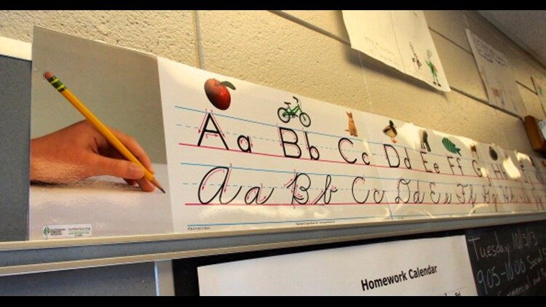
https://www.9news.com/article/news/ohio-bill-would-require-teaching-cursive-writing-in-schools/411064063

Slide 14
Christ is our copy-head.
Our lives need to copy His.
Our efforts may be rough and awkward at the beginning.
Sensible students do not quit on the first try.
Eventually, students reach a degree of success that was impossible when they first began.

Slide 15
We should follow His steps.
Like a child that imitates an adult, we should follow Christ.
We need to walk as He walked.
⁶ “He who says he abides in Him ought himself also to walk just as He walked” (1 John 2:6).
He had no sins, and there was no guile in His mouth (cf. 1 Peter 2:22).

Slide 16
Conclusion:
Suffer with patience.
Christ endured evil on our behalf.
Christ set a perfect example for us so that we can follow in His steps.

