Slide 1
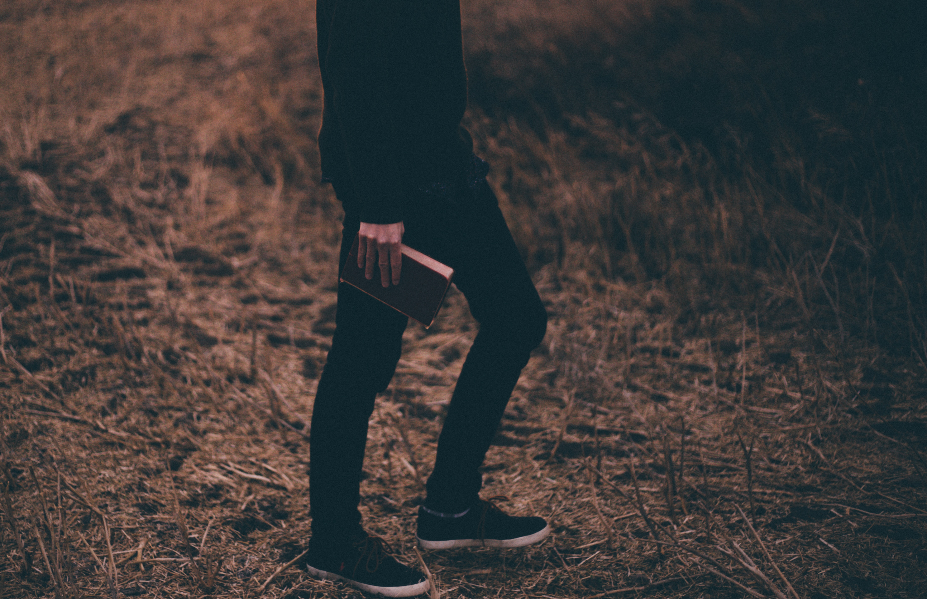
An Estimate of Christ
(Matthew 16:13-16)

Slide 2
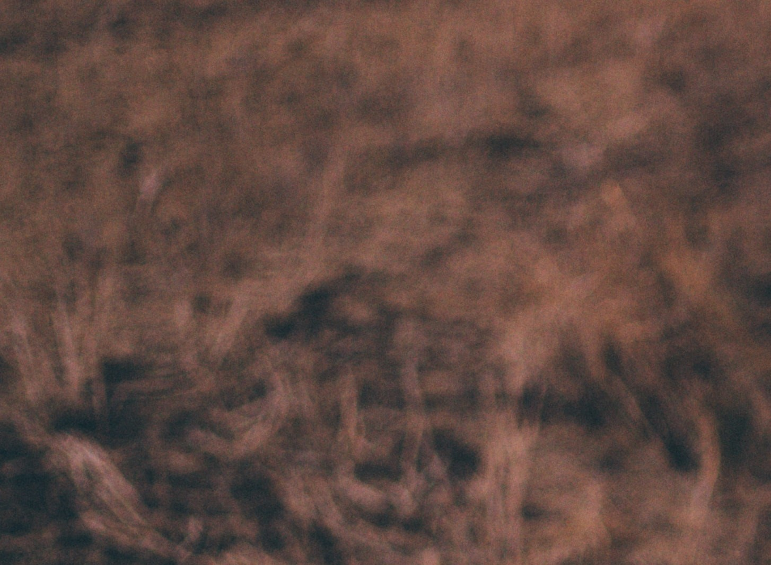
Introduction
Just as the sun is the center of our solar system, the Son is the center of Christian thought.
Our attitude is determined by our estimate of Christ.
“Who do you say, that I, the Son of man, am?”
The answer to the Lord’s question is of utmost importance.

Slide 3
What do people say?
So they said, “Some say John the Baptist, some Elijah, and others Jeremiah or one of the prophets” (Matt. 16:14).
The next day John saw Jesus coming toward him, and said, “Behold! The Lamb of God who takes away the sin of the world!” (John 1:29-31).

Slide 4
What do people say?
So they said, “Some say John the Baptist, some Elijah, and others Jeremiah or one of the prophets” (Matt. 16:14).
Now after six days Jesus took Peter, James, and John his brother, led them up on a high mountain by themselves; ² and He was transfigured before them. His face shone like the sun, and His clothes became as white as the light. ³ And behold, Moses and Elijah appeared to them, talking with Him (Matt. 17:1-3).

Slide 5
What do people say?
So they said, “Some say John the Baptist, some Elijah, and others Jeremiah or one of the prophets” (Matt. 16:14).
Jeremiah foretold the captivity of God’s people.
Jeremiah wept for Israel.
He was one of the prophets.
Jesus was none of these. He is the Son of God!

Slide 6
What do Pilate say?
Pilate thought that Jesus was a good man. “I find no fault in him” (John 19:6).
“Behold the man” (John 19:5).
“Behold your King” (John 19:14).
Once, Jesus stood in judgment before Pilate.
Someday, Pilate will stand in judgment before Jesus.

Slide 7
What do modern people say?
He was good man.
He was a good Jewish teacher.
Some claimed that he was a blasphemer (Matt. 3:17; 17:5).
Some believe that he is the Son of God; others think that Buddha is the answer.
Some believe that he is the Son of God, but they think that we do not have to obey him.

Slide 8
What was Peter’s answer?
Simon Peter answered and said, “You are the Christ, the Son of the living God” (Matt. 16:16).
What was Paul’s answer?
For this reason I also suffer these things; nevertheless I am not ashamed, for I know whom I have believed and am persuaded that He is able to keep what I have committed to Him until that Day (2 Timothy 1:12).

Slide 9
What was your answer?
³² “Therefore whoever confesses Me before men, him I will also confess before My Father who is in heaven. ³³ But whoever denies Me before men, him I will also deny before My Father who is in heaven.

