Slide 1
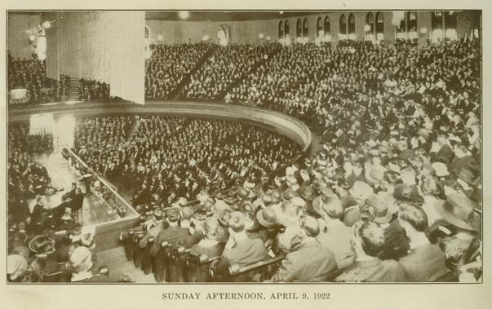
Jesus, the Model Preacher
(Romans 10:13-15)

Slide 2
Introduction:
Preaching is essential to salvation.
The apostles were told to preach. “And He said to them, “Go into all the world and preach the gospel to every creature. He who believes and is baptized will be saved; but he who does not believe will be condemned (Mark 16:15, 16).
The apostles preached what they saw and heard. “For we cannot but speak the things which we have seen and heard” (Acts 4:20).

Slide 3
Jesus was an original preacher.
Jesus spoke as no other. “The officers answered, “No man ever spoke like this Man!” (John 7:46)
Jesus did not speak as the scribes. “He taught them as one having authority, and not as the scribes” (Matt. 7:29).
Jesus did not preach to please people. “Therefore many of His disciples, when they heard this, said, “This is a hard saying; who can understand it?” (John 6:60)

Slide 4
Jesus spoke with authority.
He spoke as He was commanded. “or I have not spoken on My own authority; but the Father who sent Me gave Me a command, what I should say and what I should speak. And I know that His command is everlasting life. Therefore, whatever I speak, just as the Father has told Me, so I speak” (John 12:49-50).

Slide 5
Jesus spoke as it was written.
When Jesus was tempted by the devil, He answered with, “It is written.”
But He answered and said, “It is written, ‘Man shall not live by bread alone, but by every word that proceeds from the mouth of God’ ” (Matt. 4:4).
Jesus said to him, “It is written again, ‘You shall not tempt the Lord your God’” (Matt. 4:7).
Then Jesus said to him, “Away with you, Satan! For it is written, ‘You shall worship the Lord your God, and Him only you shall serve’” (Matt. 4:10).

Slide 6
Jesus spoke as directed.
Do you not believe that I am in the Father, and the Father in Me? The words that I speak to you I do not speak on My own authority; but the Father who dwells in Me does the works (John 14:10).

Slide 7
Jesus spoke with conviction.
He said that there is only one way. Jesus said to him, “I am the way, the truth, and the life. No one comes to the Father except through Me” (John 14:6).
He said that there is are two gates: straight and narrow. “Enter by the narrow gate; for wide is the gate and broad is the way that leads to destruction, and there are many who go in by it. Because narrow is the gate and difficult is the way which leads to life, and there are few who find it” (Matt. 7:13, 14).

Slide 8
Jesus served only one Master.
“No one can serve two masters; for either he will hate the one and love the other, or else he will be loyal to the one and despise the other. You cannot serve God and mammon” (Matt. 6:24).

Slide 9
Jesus promoted prayer.
Jesus is the perfect Example of a person with an effective prayer life.
And the tax collector, standing afar off, would not so much as raise his eyes to heaven, but beat his breast, saying, ‘God, be merciful to me a sinner!’ (Luke 18:13).

Slide 10
Jesus condemned evil.
He condemned false doctrine. He said to them, “All too well you reject the commandment of God, that you may keep your tradition” (Mark 7:9).
He condemned hypocrisy. “Woe to you, scribes and Pharisees, hypocrites! For you travel land and sea to win one proselyte, and when he is won, you make him twice as much a son of hell as yourselves” (Matt. 23:33).

Slide 11
Jesus gave the remedy for sin.
He who believes and is baptized will be saved; but he who does not believe will be condemned (Mark 16:16).
Repentance and remission of sins should be preached in His name to all nations, beginning at Jerusalem (Luke 24:47).

Slide 12
Jesus is the model preacher.
We need Christians who will not compromise the truth.
We need Christians to stand on the whole truth.
We may not be able to preach like Paul, sing like angels, but can stand up for the truth.
Step up and say today, I will not compromise the truth, I will teach the whole truth, and I will always stand up for the truth.

