Slide 1
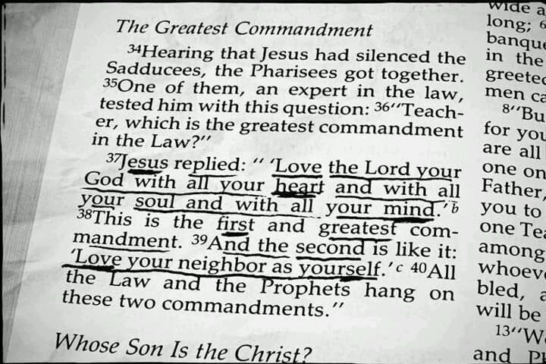
Pass the Salt Ministries
Mark 12:28-34

Slide 2
Love the Lord with all Your Heart
The heart is the part of us that feels emotions.
With the heart, we have feelings for other people.
It is possible to have deep feelings for a lot of things other than God (sports, people, material goods, politics, etc.).
First comes devotion of the mind. Next comes devotion of the heart. We generally feel deeply about our relationship with God.
Minds learn with the heart. Warm hearts intensify the desire to serve God.

Slide 3
Love the Lord with all Your Soul
The soul comes from a Greek word that often means breath.
Note how the word “soul” is used in Scripture.
People can kill the physical body, but they cannot kill the soul (cf. Matthew 10:28).
Jesus offers rest for our souls (cf. Matthew 11:29).
Our souls are worth more than the whole world (cf. Mark 8:36, 37).
Jesus’ soul was sorrowful, even to death (cf. Mark 14:34).
Our souls can be lost (cf. Luke 12:20).
“Soul” means the life within us, the breath of life.
Christians must love God enough that we would give our lives to Him.

Slide 4
Love the Lord with all Your Mind
“Mind” refers to the intellect, the thinking part of our lives.
The thinking part:
Studies the Bible
Prepares income tax
Makes discoveries
Produces inventions
Gets trained in school
Loving God with our minds is emphasized in the New Testament. For example, the Berean Christians used their minds and “searched the Scriptures daily” (Acts 17:11).

Slide 5
Love the Lord with all Your Strength
“Strength” includes our talents, abilities, and energy.
“I beseech you therefore, brethren, by the mercies of God, that you present your bodies a living sacrifice, holy, acceptable to God, which is your reasonable service” (Romans 12:1).
We use the strengths that God gave us to serve Him. We do not work to earn a place in heaven. We work because we love God and His Son, Jesus Christ.

Slide 6
Conclusion
Our relationship with God must involve our hearts, minds, souls, and strengths.
God is saying, “Give Me all you have, ever hope to be, and I will, in return, take care of you in this lifetime and in the life to come.”

